Slide 1
Vendor Performance Webinar 1
January’25

Slide 2
Points Of Contact & Reference Material
Vendor Performance Requirements Manual
Sidharth Bashyam, Sr Analyst, Vendor Performance Team – sbashyam@sallybeauty.com
Vendor Scorecard
VSEN process
Appointment Exceptions process
Tableau dashboard queries
DC/Supply chain support
James Tarvin, Analyst, Vendor Performance Team – jtarvin@sallybeauty.com
Technical support – VSEN Portal, Invoice Disputes, Appointment Exceptions, Vendor contacts, Vendor Master
Caspio and data structure queries
Allowances
Co-Op/ Promo Tools
PACT Cost Exceptions
Jeff Green, EDI Manager, Vendor Performance Team – jgreen2@sallybeauty.com
EDI and SPS Commerce
PACT
Distro Lists
vendorperformance@sallybeauty.com
edivendorperformance@sallybeauty.com

Slide 3
Tools & Definitions
PACT
Internal PO management tool serving as a one-stop shop for validating PO, PO Acknowledgement and ASN information which is communicated via EDI. Absence of mentioned EDI documents will adversely affect PO accuracy across the life cycle since all PO changes are done automatically using EDI communication.
SPS Commerce
3rd Party EDI provider serving as a conduit for all EDI communication between vendors and SBH.
EDI 850 : Purchase Order
EDI 855 : Purchase Order Acknowledgement
EDI 856 : Advance Shipment Notice (ASN)
EDI 860 : PO Change
EDI 810 : Invoice
EDI 865 : Purchase Order Change Acknowledgement
IOC
Immediate-Or-Cancel process implemented in the DC receiving process. The line on a PO remains open to receive against until the Cancel By Date (internal date) or until fully received. Pending units are auto-canceled off the line on the PO beyond the Cancel By Date.
VSEN
Vendor Shipment Error Notification portal is used to file any unit variances during receiving activity at the DC (overage/shortage/damage/canceled line). This notification is sent out to the P&A team and the vendors for quick resolution. In case of overages - either receive the product in or RTV.
Appointment Exception
The DC files an appointment exception for any requests to schedule an appointment outside the delivery window or for shipments arriving at the DC without an appointment. An exception is created are all shipments arriving before or after the assigned delivery window. Lead times must be revised, wherever necessary, to hit the beginning of the delivery window.

Slide 4
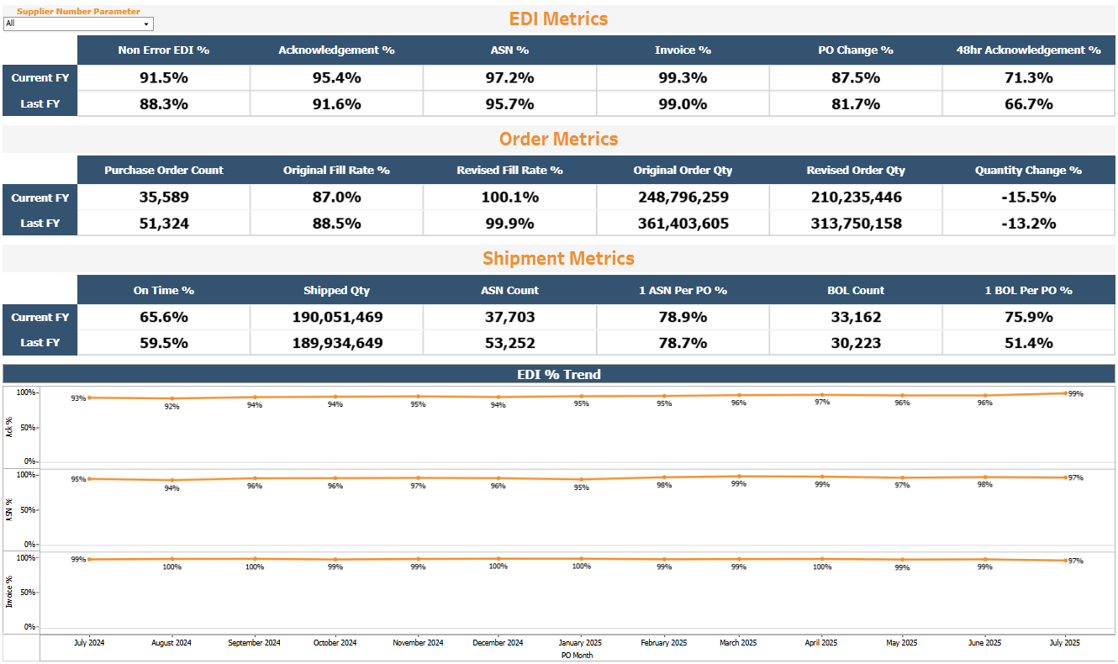
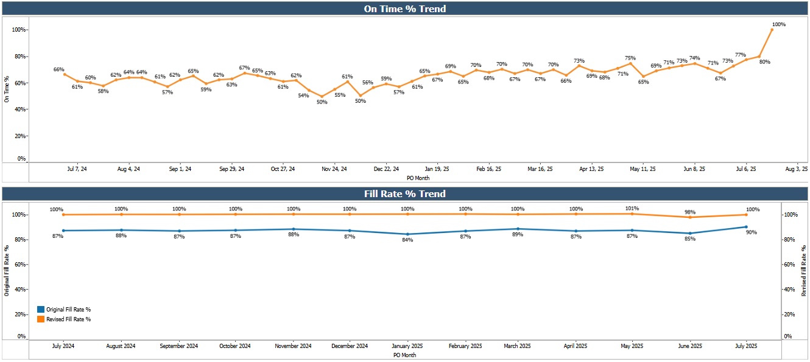
VENDOR SCORECARD SNAPSHOT

Slide 5
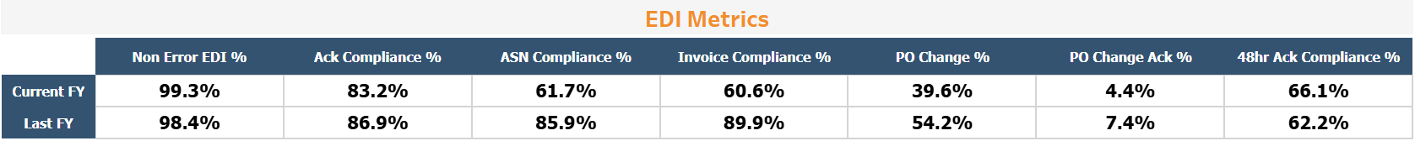
What are EDI metrics?
All EDI metric percentages are on a PO (document) level. For every 100 POs, the percentage above corresponds to the number of successful transmissions via EDI. For example, 60% ASN compliance means 60 out of every 100 POs has at least 1 ASN associated with them.
Multiple EDI transmissions of the same document type counts as ONE when calculated against a PO. For example, if a PO has 5 ASNs associated with it, the PO’s ASN compliance will still be 100% and not 500%.
Non-Error EDI % refers to the percentage of times a document (any document) passes through EDI validation in the first attempt. No EDI syntax or format errors are encountered when the vendor transmits the acknowledgement, ASN, invoice or change acknowledgement.
PO Change % is the percentage of POs that has at least one PO change document associated with them. This metric is not an indicator of a vendor’s EDI performance. It is an informational metric that is driven by PO changes that SBH makes. The lesser touches a PO has, the lower the percentage will be.
48-Hour Acknowledgement Compliance % takes into account weekends as well, giving the vendor 2 business days to send an EDI acknowledgement back to SBH.
All communication between the vendor and SBH must take place via EDI.

Slide 6
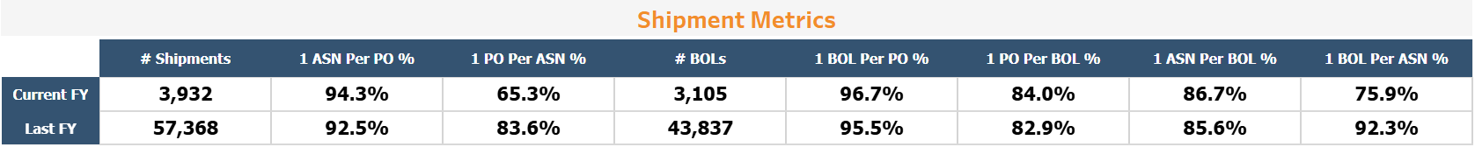
What are Shipment metrics?
All shipment metric percentages are on a PO (document) level. For every 100 POs, the percentage above corresponds to the number of POs that satisfy the corresponding condition.
Each physical truck has a BOL. This BOL can either have 1 or multiple ASNs associated with it. Each ASN can have either 1 or multiple POs associated with it.
For ease and accuracy of receiving, the ideal scenario we are aiming for is [1 BOL : 1 ASN : 1 PO].
1 ASN per PO % = For every 100 POs, how many of them have only one ASN associated with them? Vendor splits POs across multiple ASNs.
1 BOL per PO % = For every 100 POs, how many of them have only one BOL associated with them? Vendor/carrier splits POs across multiple trucks.
1 ASN per BOL% = For every 100 BOLs, how many of them have only one ASN associated with them? Sometime multiple ASNs are consolidated onto a single BOL.
ASN
BOL
ASN
PO
PO
BOL
ASN
BOL
ASN
1 PO per ASN % = For every 100 ASNs, how many of them have only one PO associated with them? Vendor consolidates multiple POs onto a single ASN.
1 PO per BOL % = For every 100 BOLs, how many of them have only one PO associated with them? Vendor/carrier consolidates POs onto a single BOL.
1 BOL per ASN % = For every 100 ASNs, how many of them have only one BOL associated with them? Sometimes a single ASN a split across multiple BOLs.
PO
PO
BOL
ASN
BOL
ASN
PO
PO
BOL

Slide 7
Appointment Exceptions
Systematically or by user in PACT
7 or more days before DW
DW to be modified
Appointment Exception created
Appointment assigned
NOT ON TIME
Before the DW
Less than 7 days before DW
Appointment Exception created
Appointment assigned
NOT ON TIME
Inside the DW
Appointment assigned
ON TIME
At least 2 days before Cancel Date
Appointment Exception created
Appointment assigned
NOT ON TIME
After the DW
Within 2 days or after Cancel Date
Extend Cancel Date
Appointment Exception created
Appointment assigned
NOT ON TIME
By user in PACT
Don’t modify DW
Changes to the delivery window (PO Extended Date in PACT) are only to be made manually when the shipment is arriving early and the delivery window needs to be changed for the product to be received in. For all other scenarios, the delivery window is to remain unchanged.
Multiple shipments against a PO need to be within the delivery window. We cannot change the delivery window multiple time. We can only change it ONCE and that too only in scenario 1 as shown above.

Slide 8
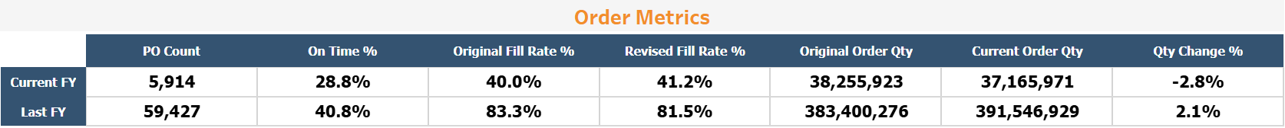
What is Fill Rate?
Original Fill Rate is calculated based on original order quantity on the original PO (850) = [Qty Received at the DC]/[Original Order Qty]
Revised Fill Rate is calculated based on current order quantity on the PO Change (860) = [Qty Received at the DC]/[Current Order Qty]
The relevant KPI for vendor compliance is Original Order Quantity. What we originally ordered vs what we ended up receiving. The revised fill rate shows how much vendors adhered to their own 855 acknowledgements.
2 scenarios of quantity discrepancies:
The vendor sends an 855 Acknowledgement requesting a change in the line quantity. The RP accepts the change and the order quantity is revised. The vendor may or may not ship 100% against this revised quantity. Could be more than 100%, could be less than 100%. (Revised Fill Rate)
The vendor sends an 855 Acknowledgement accepting all line quantities. No action from the RP is needed. The vendor may or may not ship 100% against this original quantity. (Original Fill Rate)
With the introduction of Immediate-or-Cancel (IOC), if a SKU on a PO is partially received, the line remains open to receive against up until the Cancel By Date. This is done in case a second shipment may be arriving for that PO. If no subsequent product is received by the Cancel By Date, the remaining units are canceled off the line on that date and the line is considered “Fully Received”.
Implications of reinstating a canceled PO or Line (because a shipment arrived after the IOC Date):
Another 860 will needlessly be sent to the vendor with a different line code depending on whether it was a fully canceled line or a partially received line.
If a VSEN was filed when receiving against the ASN and for some reason if the ASN is split across two shipments, reinstating the line would make the VSEN redundant.
Additional layer of complexity to manage invoice disputes since we will need to validate whether the product was reinstated or not, whether the product was received in or RTV’d or not.
Product remains unsellable to the customer as it cannot be received into inventory.

Slide 9
VSENs & Invoice Disputes
Overage/ Wrong SKU
Vendor sends return authorization and schedules pickup
Vendor picks up product from DC
60 days from VSEN date for vendor to pickup and resolve VSEN
Vendor tells us to keep the product
Overage/Shortage/Damage during DC Receiving
DC completes cycle count for PO-SKU combo
DC Files VSEN for PO-SKU Combo
Communication sent to P&A, Merch, AP and Vendor
Action taken to resolve by internal/external partners
Line canceled on PO
DC disposes of product sustainably
7 Calendar Days to file
30 days from VSEN date for vendor to first respond
Line reinstated by P&A
Product added to inventory after consulting with P&A
60 days from VSEN date for vendor to inform us
Shortage/Damage
No action
30 days from Remittance Date to dispute
Vendor files Invoice Dispute on Dispute Portal
Yes
Double check VSEN details
NO PAY
VSEN Filed Timely?
No
VP team completes due diligence with AP & DC
PAY – Check Request created and sent to AP

Slide 10
To Summarize..
The 3 areas of opportunity that would significantly move the needle in the right direction would be:
1. 100% use of EDI for the all document transmission and communication of any changes.
Email and phone call communication between the vendor and P&A brought down to zero.
All these documents and changes will systematically be tracked and maintained in PACT.
2. 100% On-Time for all shipments by arriving within the ORIGINAL delivery window.
No split shipments (1 ASN per PO). No consolidating shipments (1 PO per ASN).
The delivery window is to be tweaked ONLY when receiving at the DC becomes a problem.
3. 100% In-Full on all SKUs on the original PO, ideally.
Ship the correct SKUs for the correct quantity.
No visible or concealed overages.
ASN accuracy is imperative (what is on the ASN should match what is physically in the truck).
Fill it or kill it.

Slide 11
Vendor Performance Webinar 2
April’25

Slide 12
Points Of Contact & Reference Material
Vendor Performance Requirements Manual
Sidharth Bashyam, Manager, Vendor Performance Team – sbashyam@sallybeauty.com
Vendor Scorecard
VSEN process
Appointment Exceptions process
Tableau dashboard queries
Invoice Disputes
DC/Supply chain support
James Tarvin, Analyst, Vendor Performance Team – jtarvin@sallybeauty.com
Technical support – VSEN Portal, Invoice Disputes, Appointment Exceptions, Vendor contacts, Vendor Master
Caspio and data structure queries
Allowances
Portal access
Jeff Green, EDI Manager, Vendor Performance Team – jgreen2@sallybeauty.com
EDI and SPS Commerce – successful/failed transmissions
Vendor EDI setup
Carton/Pallet label EDI verification
Distro Lists
vendorperformance@sallybeauty.com
edivendorperformance@sallybeauty.com

Slide 13
On Time – Road To Success
A shipment is considered ON TIME if: [Do Not Deliver Before] <= [Appointment Date] <= [Do Not Deliver After]
Best practices and things to keep in mind:
We encourage vendors to ship only ONCE against a PO but in cases where multiple shipments are required for a single PO, all shipments must have an appointment date within the delivery window. On-Time is calculated on a PO level. If even 1 of the shipments is outside the window, the entire PO is considered Not On-Time.
Shipments arriving at the DC without an appointment with negatively effect on-time.
Always aim for the beginning (1st day or 2nd day) of the delivery window – to account for inclement weather, truck breakdown, lack of dock space at the DC etc.
Vendors/Carriers must request for an appointment as early in the PO life cycle as possible, to have the maximum chance of getting the appointment they ask for (appointment scheduling is first come, first serve).
For LTL shipments, after transmitting the ASN, the sooner the carrier emails for an appointment, the higher chance they have of getting the appointment date this requested for. It is extremely difficult to provide appointments last minute since the DCs receiving schedule can potentially fill up days in advance.
For FTL shipments, make sure the ASN has been transmitted via EDI before the truck arrives at the dock. Without an ASN, the truck will be sent back and a new appointment will be issued. There is no guarantee that this new appointment will be inside the delivery window.
Systematically, the Delivery Window will never be changed, unless a date change is communicated to us via the EDI 855 Acknowledgement.
You might want to revisit your lead times in our systems if you feel you don’t have enough time to pick/pack/ship/deliver product to our DCs. The link to do so can be found here - https://c6eib458.caspio.com/dp/68718000abbea713e0b9487fa0c6
Sometimes carriers tend to consolidate LTL shipments at their pool points after picking up from vendors’ pick-up points. So they make be picked up on time but are delivered to SBH late. The appointment exceptions filed give visibility to instances of this happening.

Slide 14
EDI Metrics
All EDI metric percentages are on a PO (document) level. For every 100 POs, the percentage above corresponds to the number of successful transmissions via EDI. For example, 60% ASN compliance means 60 out of every 100 POs has at least 1 ASN associated with them.
Multiple EDI transmissions of the same document type counts as ONE when calculated against a PO. For example, if a PO has 5 ASNs associated with it, the PO’s ASN compliance will still be 100% and not 500%.
Non-Error EDI % refers to the percentage of times a document (any document) passes through EDI validation in the first attempt. No EDI syntax or format errors are encountered when the vendor transmits the acknowledgement, ASN, invoice or change acknowledgement.
PO Change % is the percentage of POs that has at least one PO change document associated with them. This metric is not an indicator of a vendor’s EDI performance. It is an informational metric that is driven by PO changes that SBH makes. The lesser touches a PO has, the lower the percentage will be.
48-Hour Acknowledgement Compliance % takes into account weekends as well, giving the vendor 2 business days to send an EDI acknowledgement back to SBH.
Since receiving at the DC is done using the ASN, it’s accuracy on a SKU level directly affects accuracy of receiving and accuracy of payment.
Use of EDI 855 Acknowledgement:
1. Change Delivery Windows – to increase chances of being On-Time
2. Change Unit Quantities – to get to 100% Fill Rate
3. Change Cost/Allowances – to get more accuracy and timely (invoice matching)
4. Communicate SKUs on backorder

Slide 15
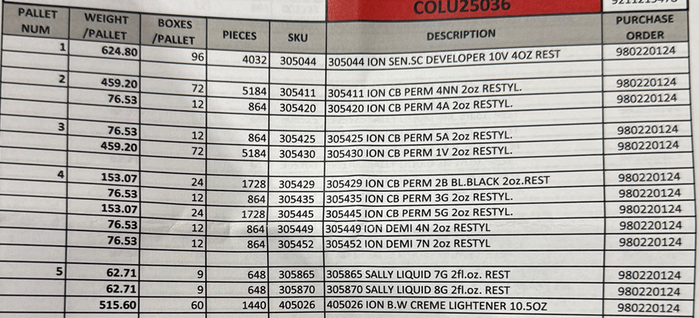
Carton Label, Pallet Label and Packing Slip Requirements
Pallet Label
Carton Label
Packing Slip
Important questions the DC should be able to answer:
Which POs are on this pallet?
Is this pallet single SKU or mixed SKU? Which SKUs are on this pallet?
How many cartons are on this pallet for each SKU? How many total cartons?
Which pallet number is this – 1 of 30? (not shown above). 30 is the total number of pallets on the shipment.
Important questions the DC should be able to answer:
Which PO is this carton for?
Which SKU is this carton for?
Is the barcode scannable to show correct UPC?
How many eaches/units are in this carton?
Which carton number is this – 1 of 100? 100 is the total number of cartons on the pallet.
Important questions the DC should be able to answer:
Which POs and SKUs are on this shipment?
How many total cartons are on this shipment?
Does it show carton count and unit count by SKU?
How many pallets are on this shipments? (not shown above)

Slide 16
VSENs & Invoice Disputes
Overage/ Wrong SKU
Vendor sends return authorization and schedules pickup
Vendor picks up product from DC
60 days from VSEN date for vendor to pickup and resolve VSEN
Vendor tells us to keep the product
Overage/Shortage/Damage during DC Receiving
DC completes cycle count for PO-SKU combo
DC Files VSEN for PO-SKU Combo
Communication sent to P&A, Merch, AP and Vendor
Action taken to resolve by internal/external partners
Line canceled on PO
DC disposes of product sustainably
7 Calendar Days to file
30 days from VSEN date for vendor to first respond
Line reinstated by P&A
Product added to inventory after consulting with P&A
30 days from Remittance Date to dispute
Vendor files Invoice Dispute on Dispute Portal
60 days from VSEN date for vendor to inform us
Shortage/Damage
No action
Yes
Double check VSEN details
NO PAY
VSEN Filed Timely?
No
VP team completes due diligence with AP & DC
PAY – Check Request created and sent to AP
SBH effort to support:
DC visits to align receiving process to vendor performance requirements to increase efficiency and minimize potential errors.
Alignment and training with internal stakeholders for smoother communication and dispute resolution.
Working through the backlog to research disputes without VSENs.
Aged receipts are harder to research and verify.
Disputes with inaccurate ASNs cannot be researched or validated.

Slide 17
Dashboard Links
Vendor Portal: https://c6eib458.caspio.com/dp/68718000abbea713e0b9487fa0c6
Views available –
VSEN Dashboard
Invoice Dispute Webform
Invoice Disputes Dashboard
Account Setup Webform
Warehouse Lead Time Webform
Appointment Exceptions Dashboard
*Questions on BOX reports to be redirected to P&A team.

Slide 18
Vendor Performance Webinar 3
July’25

Slide 19
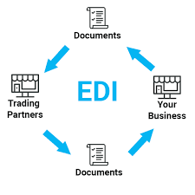
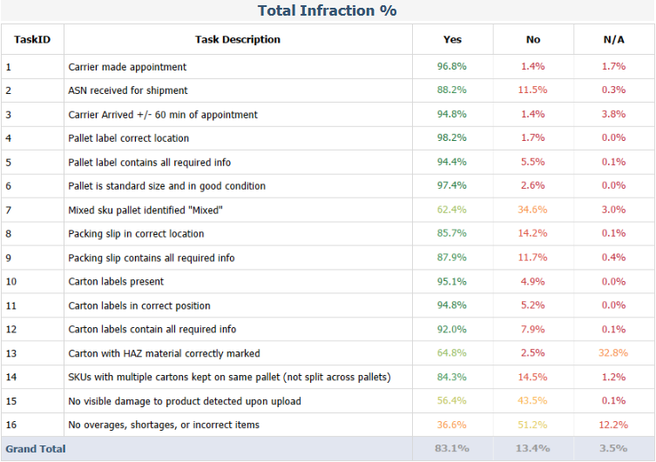

Areas of Focus
EDI Document Accuracy and Best Practices
Carton Labels, Pallet Labels, Packing Slips
Load Evaluation/Audits
(PO Level)
Delivery Windows and ASN Requirement

Slide 20
EDI 855 Acknowledgements – Header Level
SBH must receive an 855 Acknowledgement within 2 business days of receipt of purchase order. You may use one of the following header-level codes:
AK – Acknowledged as is
The entire PO is accepted as is, without any changes to the SKUs regarding delivery dates, order quantities, price/cost and allowances (if applicable). No line-level detail required.
AD – Acknowledged as is with detail
The entire PO is accepted as is, without any changes to the SKUs regarding delivery dates, order quantities, price/cost and allowances (if applicable). Line-level details are required, and you must us the line-level code IA for all items.
AC – Acknowledged with changes
The PO is accepted with changes to at least 1 SKU on the PO. Changes can be made to any number of items on the PO. This change can be to the delivery window dates, order quantities, item price/cost or allowances (if applicable). If multiple changes need to be made to the same item, all relevant line-level change codes must be used against that item.
RJ – Rejected
The entire PO is rejected with a rejection reason. No line-level detail required.
RD – Rejected with detail
The entire PO is rejected with a rejection reason. Line-level details are required, and you must us the line-level code IR for all items.
Notes:
PO Acknowledgement (EDI 855)
Thorough review of each order is expected before sending a PO Acknowledgement (EDI 855)
The EDI 855 is when you should notify SBH of changes you feel need to be made to an order for the following
Quantity
Delivery window dates
Item pricing
Items you cannot ship
Do not send cut reports via email – you must use the EDI 855
Transmit your 855 within 48 hours (2 business days) of receipt of an order
We ask that you only send one 855 per order
SBH may not make all requested changes or may remove an item from the order to better meet your requested changes

Slide 21
EDI 855 Acknowledgements – Line Level
When the AC code is used, it must be accompanied by at least one of the following line-level codes. SBH reserves the right to either accept your requested changes or take no action.
DR – Date reschedule
If item cannot be delivered in the delivery window mentioned on PO, the delivery window must be changed using this code. Delivery window dates apply to all items on the order. Changing the window for 1 item changes the window for all items. New (valid) dates must be mentioned and will affect the entire PO. Item is expected to remain on the PO.
IB – Item backorder
This code must be used if the item is on backorder. You must provide an updated “Do Not Deliver After” date to alert SBH when the item will be available for ordering. If the RP accepts the change, the delivery window for the entire PO will be updated. If the RP rejects the change, the item will be removed from the PO and the original delivery window will remain in effect.
IP – Price/cost change
This code must be used if the price mentioned for the item is incorrect. Also work with your Merch partner to have the price updated in the system so that subsequent POs are sent out with the updated price. New price must be provided. Item is expected to remain on the PO.
IQ – Quantity change
This code must be used if the number of the units/eaches for the item need to be increased or decreased. New quantity must be provided. Item is expected to remain on the PO.
IR – Item rejected
If an item needs to be removed from the PO entirely, IR code is used. You must include a reject reason in the text segment.
If no changes need to be made to the line, please use the IA code. This confirms that the item has been accepted as is – correct dates, correct price, correct quantity and correct allowances (if applicable).

Slide 22
EDI 856 ASNs
ASNs must be sent for all shipments being sent to SBH. Ideally, only 1 ASN is to be sent per PO – unless the order qty is larger than a full truckload.
Appointments for shipments will not be provided if an ASN is not available.
For LTL shipments, the ASN must be sent as soon as you’re able to enter the truck information on the ASN. Ideally, the ASN is transmitted as the truck is leaving your warehouse. This gives ample time for the ASN to be transmitted via EDI and be available for the SBH DCs to see/use. Then, when the carrier emails for an appointment, we have the ASN available.
For FTL shipments, the ASN must be received by SBH before the truck arrives at the SBH warehouse. Ideally, one day in advance. The morning of for shorter transit times.
The ASN must accurately reflect the contents of each shipment, on a line level. Any hidden/concealed overages will be returned to the vendor or disposed of. The ASN is the baseline used to generate VSEN reporting.
ASNs can be generated on a:
Carton level - The GS1-128 labels for the shipment must be present on each carton and each carton GS1-128 SSCC number must be referenced in the ASN.
Pallet level - The GS1-128 labels for the shipment must be present on each pallet and each pallet GS1-128 SSCC number must be referenced in the ASN.
Please ensure the following fields have valid and accurate information:
Ship Notice #
Bill Of Lading # or Carrier Pro #
Ship To Location ID – The DC number entered here must match the DC number on the PO.
FOB Pay Code – PP or CC (to indicate prepaid or collect freight terms)
Carrier Alpha Code
Carrier Routing
Lot Number and Expiry Date – Please fill in this segment accurately, if applicable (if there is a “Sell By” date).
Notes:
Advance Ship Notice (ASN or EDI 856)
You must successfully transmit an ASN (EDI 856) for each shipment for delivery to be made to an SBH DC
The ASN must accurately reflect the contents of each shipment
Please ensure use of the GS1-128 label for each shipment and each carton number is referenced in the ASN
The ASN is the baseline used for VSEN reporting of shortages and overages

Slide 23
EDI Best Practices
Acknowledgements
Only make changes corresponding to the correct EDI line-level code.
Use the IR code only when you will not ship an item. If you intend to ship but changes need to be made, please use IP, IQ, DR, IB.
If using the DR code to make date changes, please do so on the line-level and as early in the PO life cycle as possible. Last minute changes to the delivery window may not be accommodated.
Always double-check the price and allowances to ensure order accuracy. The invoice may not be paid as presented in case of mismatches between the PO and invoice.
If allowance on the PO are incorrect, please use the IR code to reject the line and mention the rejection reason in the notes section.
ASNs
Use of the GS1-128 labels should match the structure of the ASN (pallet or carton).
Invoices
All allowances present on the PO must be present on the EDI 810 invoice. Else, it will fail validation at SPS.
Please ensure the EDI 855 Acknowledgement reconciled with the EDI 810 Invoice. Use the EDI 855 Acknowledgement to resolve potential invoice problems, prior to shipping and invoicing.
Notes:
Purchase Order (EDI 850)
The delivery window pertains to all items on the order
The delivery window is determined by the lead times we have for you company
PO Change (EDI 860)
SBH PO Change documents (EDI 860) only send items with changes. We do not send replacement orders
Please update your system when receiving a PO Change to minimize shipping and invoicing errors

Slide 24
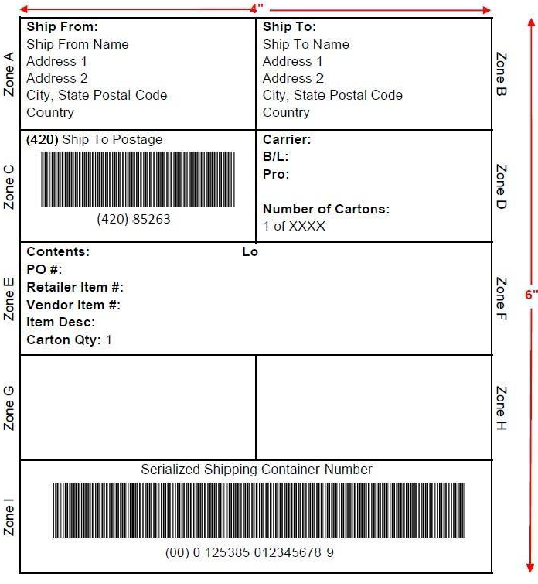
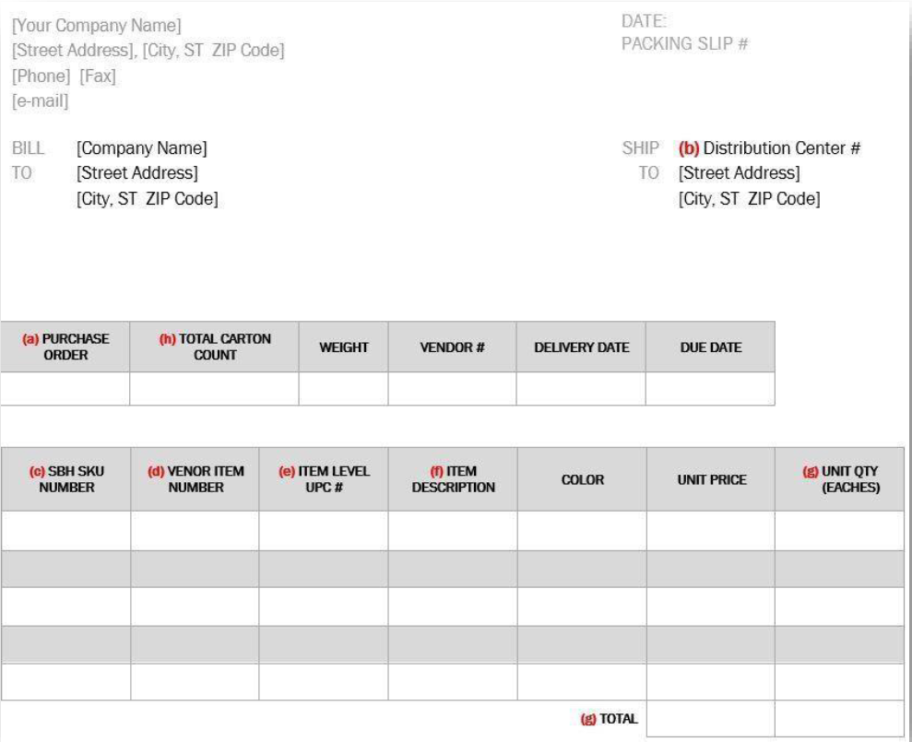
Carton Label, Pallet Label and Packing Slip Requirements
Pallet Label
Carton Label
Packing Slip
Important questions the DC should be able to answer:
Which POs are on this pallet?
Is this pallet single SKU or mixed SKU? Which SKUs are on this pallet?
How many cartons are on this pallet for each SKU? How many total cartons?
Which pallet number is this – 1 of 30? (not shown above). 30 is the total number of pallets on the shipment.
Important questions the DC should be able to answer:
Which PO is this carton for?
Which SKU is this carton for?
Is the barcode scannable to show correct UPC?
How many eaches/units are in this carton?
Which carton number is this – 1 of 100? 100 is the total number of cartons on the pallet.
Important questions the DC should be able to answer:
Which POs and SKUs are on this shipment?
How many total cartons are on this shipment?
Does it show carton count and unit count by SKU?
How many pallets are on this shipments? (not shown above)

Slide 25
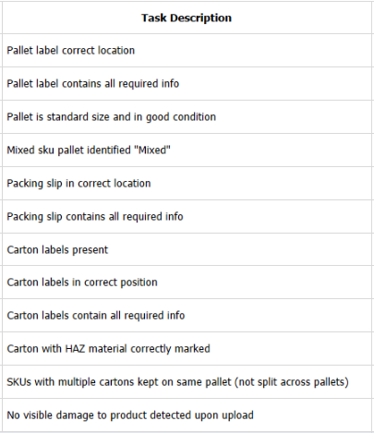
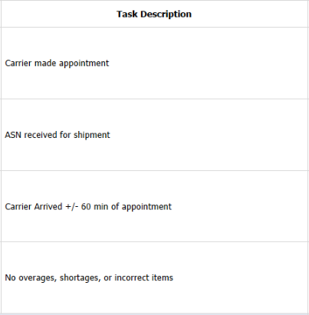
Load Evaluation
Every shipment that arrives at our DCs goes through an audit to make sure it passes SBH receiving standards. These audits occur for all inbound shipments on a PO level. The audit is completed to ensure swift and accurate receiving, ultimately leading to timely and accurate payments.
The answer to each task will either be YES, NO or N/A. Load Evaluation % per PO = { [ (Count of YES) + (Count of N/A) ] / 16 } * 100
Below is the list of requirements:
Carton/pallet level audit
Shipment level
audit
Additional information regarding carton and pallet requirements can be found in the Vendor Requirements Manual here:
https://www.sallybeauty.com/about/vendor-compliance-guide/

Slide 26
ASN Requirement and On Time Delivery – Road To Success
A shipment is considered ON TIME if: [Do Not Deliver Before] <= [Appointment Date] <= [Do Not Deliver After]
Best practices and things to keep in mind:
We encourage vendors to ship only once against a PO but in cases where multiple shipments are required for a single PO, all shipments must have an appointment date within the delivery window. On-Time is calculated on a PO level. If even 1 of the shipments is outside the window, the entire PO is considered Not On-Time.
Shipments arriving at the DC without an appointment will be refused and will negatively effect on-time.
Always aim for the beginning (1st day or 2nd day) of the delivery window – to account for inclement weather, truck breakdown, lack of dock space at the DC etc.
Vendors/Carriers must request for an appointment as early in the PO life cycle as possible, to have the maximum chance of getting the appointment they ask for (appointment scheduling is first come, first serve).
For LTL shipments, after transmitting the ASN, the sooner the carrier emails for an appointment, the higher chance they have of getting the appointment date this requested for. It is extremely difficult to provide appointments last minute since the DCs receiving schedule can potentially fill up days in advance.
For FTL shipments, make sure the ASN has been transmitted via EDI before the truck arrives at the dock. Without an ASN, the truck will be sent back, and a new appointment will be issued. There is no guarantee that this new appointment will be inside the delivery window.
Systematically, the Delivery Window will never be changed, unless a date change is communicated to us via the EDI 855 Acknowledgement.
You might want to revisit your lead times in our systems if you feel you don’t have enough time to pick/pack/ship/deliver product to our DCs. The link to do so can be found here - https://c6eib458.caspio.com/dp/68718000abbea713e0b9487fa0c6
Make sure carriers do not consolidate LTL shipments at their terminals after picking up from vendors’ pick-up points. So, they make be picked up on time but are delivered to SBH late. The appointment exceptions filed give visibility to instances of this happening.
With the introduction of Manhattan Active (new warehouse management system) starting FY26, shipments will not be scheduled without an ASN. Unfortunately, we cannot make any exceptions to this rule as the new warehouse management system will not allow it. No ASN, no appointment, no delivery.

Slide 27
To Summarize
https://pcaralteryx01/gallery/#!/app
Use the correct header-level and line-level EDI codes to ensure smooth flow of product. The Acknowledgement must match the ASN and the Invoice.
Cartons, pallets and packing slips must be up to SBH compliance standards. All shipments are also evaluated based on label requirements and appointment/ASN punctuality.
An ASN is required for scheduling all inbound shipments and appointments must be requested within the delivery window for each PO, as early as possible.

Slide 28


Vendor Performance Webinar Q1 FY2026
November 2025
Sidharth Bashyam - Manager
Jeff Green - EDI Manager
James Tarvin - Data Systems Coordinator
Krissy Casey - Sr Analyst

Slide 29

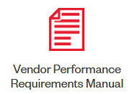




Program Objectives
01
02
03
Establish compliance requirements and KPIs, develop compliance reporting
100% use of EDI for all communication and documents transfer
Maximize efficiency of warehouse inbound receiving processes
Timely and accurate payments to vendors

Slide 30
Vendor Performance In Numbers – FY2025
472
Active Supplier Numbers
46k
POs Written
332M
Units Ordered
298M
Units Received
96%
EDI
70%
On Time
90%
Fill Rate
92%
3-Way Match
88%
Load Evaluation
93% Acknowledgements
96% ASNs
99% Invoices
Notes:
Started this FY EDI at 99%, on time at 71%, fill rate at 93%​
3WM at 96% and Load Eval at 85%​
1 PO: 1 ASN: 1 BOL - FY24 @ 75%, FY25 @ 79%, FY26 at 92%​
​
Total 800 disputes for FY25. 60% in q1 and q2, 40% in q3 and q4. Lets say avg 67 disputes per month. 15 disputes this month – lowest since process start in May2024.​
Q1 48% disputes with VSENs, Q4 85% disputes with VSENs. Started this quarter at 93%​

Slide 31
Key Strategic Initiatives – FY2025
Invoice Disputes Process
Evaluate payment discrepancies due to receipt quantity variance
Analyze vendor invoices to identify additional short-pay reasons
Build 2-way communication portal to file invoice disputes
Establish manual payment process to pay relevant invoices
Appointment Exceptions
Establish process to proactively identify early/late shipments
Requirement of an ASN to schedule and/or unload shipments at warehouses
External communication to relevant stakeholders to build transparency
Develop reporting to track infractions and perform root cause analysis
Vendor Portal
Create a one-stop shop for vendors, replacing email communication
Centralized location to track VSENs, invoice disputes and appointment exceptions
Lead time updates pushed to relevant stakeholders automatically
Portal access requests and password resets
Vendor contact database
Vendor Outreach
Quarterly webinars to discuss current state, areas of opportunity and tips to succeed
Updated SBH website provides access to training decks, requirements manual, EDI specs etc.
Monthly vendor scorecard rollout
Knowledge share through weekly/monthly touch bases with vendors

Slide 32

Road To Success!
1 PO : 1 ASN : 1 BOL
ASN (EDI 856)
Acknowledgement (EDI 855)
1st day of the delivery window
Appointments are first come, first serve
Lead times
SBH Support –
Dock space availability
Real-time ASN availability
Lead time validation
Appointment exceptions
Notes:
1 PO : 1 ASN : 1 BOL – Avoid split shipments
Always send us the ASN (EDI 856) via EDI as early as possible
Use the PO acknowledgement (EDI 855) to communicate all delivery date changes, via EDI
Aim for the first day of the delivery window
Schedule appointments at the warehouse as early as possible – appointments are first come, first serve
Help us update your transportation lead times in our system

Slide 33

Road To Success!
On-time delivery
Invoice (EDI 810) – EDI submission, Line-level accuracy
Acknowledgement (EDI 855) – Prices, Allowances
ASN (EDI 856) – EDI submission, Line-level accuracy
Carton labels, pallet labels and packing slips
SBH Support –
Dedicated resource for quicker dispute resolution
Processes in place to maximize receiving accuracy
Swim lanes to identify correct point of contact based on issue
EDI support for invoice (EDI 810) transmission
Notes:
Deliver product on time to avoid PO cancellations
Always send us the invoice (EDI 810) via EDI as early as possible
Use the PO acknowledgement (EDI 855) to communicate all price/cost changes and allowance discrepancies, via EDI
Line-level ASN (VSENs) and invoice accuracy (3-way match). Also, received product matches invoice.
Use of compliant carton labels, pallet labels and packing slips
Non-compliance will lead to No Pay

Slide 34
FY2026 Focus
Shipment Quality Audit
Line-Level EDI Compliance
New WMS
Manhattan Active
Compliant shipments
= Faster, more accurate receiving
= Timely and accurate payments
Compliant EDI documents
= Cleaner PO life cycle
= More accurate receiving
= Higher 3-way match
= Timely and accurate payments
Increased automation and capability
= System driven exception reporting
= Faster, more accurate receiving
= Timely and accurate payments
Notes:
Shipment Quality Audit:
Establish KPIs to audit shipment quality from unloading to receiving
Process training at warehouse to maximize data entry accuracy
Vendor training on risks and best practices
Develop reporting to measure progress and identify problem areas
Line level EDI compliance:
Vendor outreach to share best practices on use of Acknowledgements, ASNs and Invoices
EDI Scorecard to identify positive and negative trends in vendor behavior
Internal compliance scorecard to highlight bottlenecks in PO life cycle management
New WMS:
Monitor effects of new warehouse management system on vendor performance KPIs
Support tool setup and UAT
Warehouse receiving process training – VSENs and appointment scheduling

Slide 35
Shipment Quality Audit

Slide 36
Pre Arrival
Carrier made an appointment
All shipments except small parcel (UPS, Fedex) during an appointment for delivery...
ASN received for shipment
FTL – ASN required during delivery LTL – ASN required during scheduling
Carrier arrived +/- 60 min from appointment
Delivery must adhere to appointment date as well as time. DC reserves the right to refuse late/early shipments.
Pallet label in correct location
Upper right corner of each pallet. GS1-128 pallet label (pallet level ASN) or human readable pallet label.
Pallet label contains all required information
PO Number, DC, SBH SKUs, UPCs, Carton count by SKU, Total carton count on pallet, Total SKU count on pallet, Pallet sequence number
Pallet is standard size and in good condition
Maximum pallet height is 55”, Wooden pallets, No Overhang, No misaligned cartons.
Mixed SKU pallet identified “Mixed”
“Mixed” sticker clearly visible on each pallet with more than 1 SKU. Avoid mixed PO pallets.
SKUs with multiple cartons on same pallet
All cartons of a single SKU must be on same pallet unless carton count exceeds size of full pallet.
Product Audit

Slide 37
Product Audit (contd.)
Packing slip in correct location
Exterior sleeve beside pallet label on pallet closest to truck door, facing outward...
Packing slip contains all required information
DC, All POs, SBH SKU+UPC+Description list of each PO, Carton count of each SKU on each PO, Unit count of each SKU on each PO, Total pallet count, Total carton count, Total unit count.
Carton label present
Each carton must have a GS1-128 label (carton level ASN) or human readable carton label.
Carton label in correct location
Longest/tallest side of carton.
Carton label contains all required information
PO, DC, BOL, SBH SKU (single SKU carton ONLY), UPC, Description, Carton sequence number, Item qty in carton
Carton with HAZ material marked correctly
Hazmat sign required on each carton with HAZ material.
No visible damage to product upon unload
Visible pallet/carton damage before unloading. BOL will not be signed or will mention damaged pallet count.
No overages, shortages or damages
On unit level. Cannot be verified before BOL is signed. VSENs filed after receiving is complete.
O/S/D

Slide 38
Additional Requirements
Carton integrity
Sealed properly, maintain structural integrity, use cardboard boxes, sustainable inner void packing material...

Slide 39
Let’s win together!

